Slide 1
ISQA 8206/4200
Exclusive rights to these
slides held by
Lotfollah Najjar
ISQA- UNO

Slide 2
Introdouction
UNDERSTAND THE CUSTOMER
By L.Najjar

Slide 3
Performance Measurement Paradigm
Step 1: Understanding the customers’
requirements (set of attributes)
Step 2: Translating those attributes into
product or service specifications
Step 3: The measurement of process
effectiveness
Step 4: The measurement of customer
satisfaction

Slide 4
Three Points Regarding the First Two Steps
Identify the output
2. Identify the customer
3. Identify the customer requirements

Slide 5
2. Identifying the Customer
Internal vs. external customers
Buyers vs. users
Price vs. performance
Suppliers

Slide 6
3. Learning the Customers’ requirements
their expectations can be determined by
answering three questions:
What product/service attributes do customers want?
What performance level is needed to satisfy their
expectations?
What is the relative importance of each attribute?

Slide 7
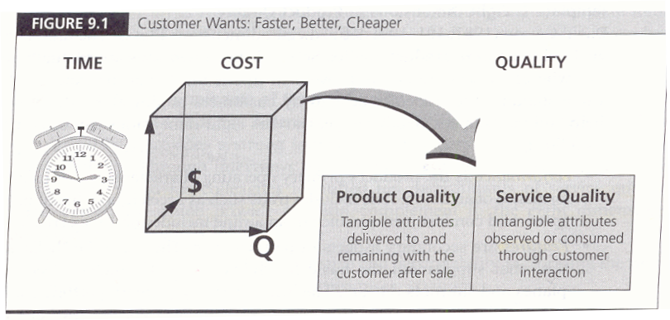

Slide 8
Template 1:Eight Dimensions of Product Quality
Performance
Features
Reliability
Conformance
Durability
Serviceability
Aesthetics
Perceived quality
Garvin (1987)

Slide 9
Template 2: Ten Dimensions of Service Quality
1. Reliability
2. Responsiveness
3. Competence
4. Accessibility
5. Courtesy
6. Communication
7. Credibility
8. Security
9. Understanding the customer
10. Tangible
Berry, Zeithmal, and Parasuraman

Slide 10
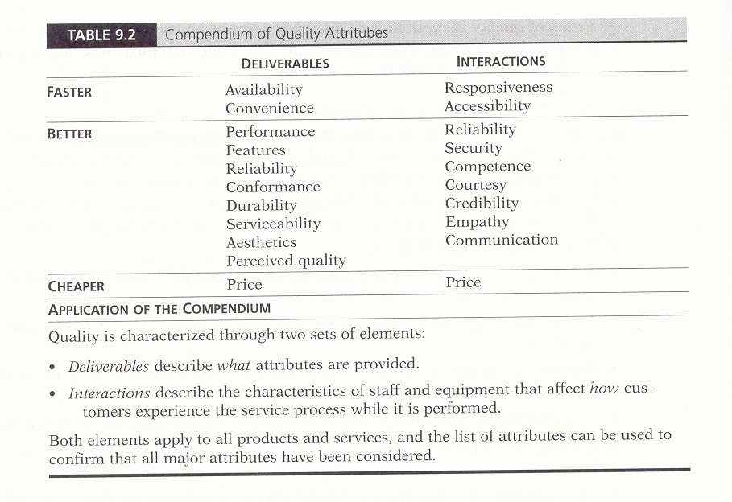
Template 3

Slide 11
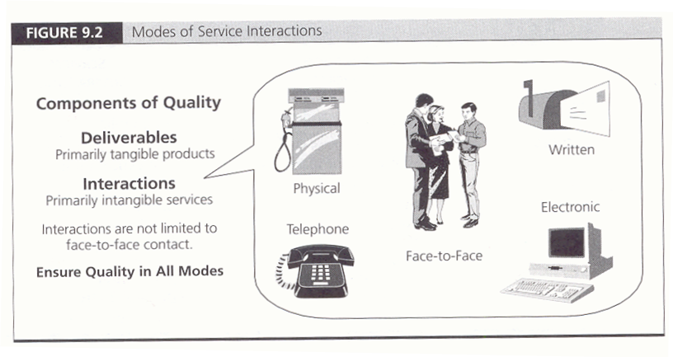

Slide 12
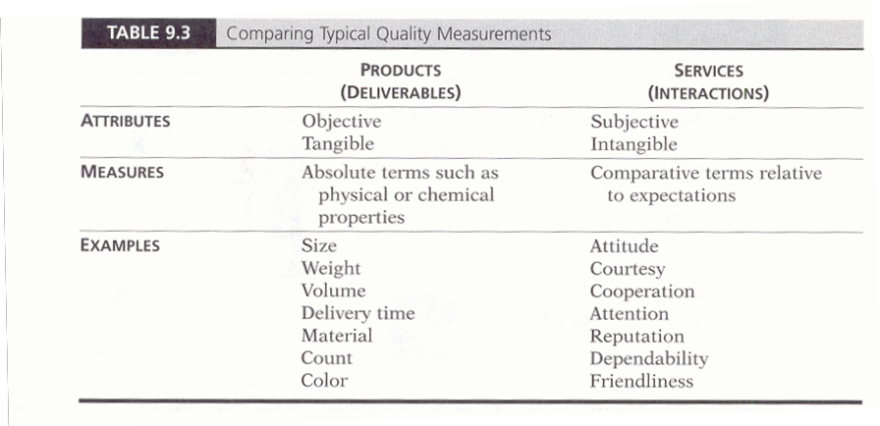
Translating Attributes Into Specifications

Slide 13
The Multiple Dimensions of Information Quality

Slide 14
Four Categories of Data Quality
Intrinsic DQ
Contextual DQ
Representational DQ
Accessibility DQ

Slide 15
Intrinsic DQ
Intrinsic DQ – The quality of the data is directly knowable from the data and may be evaluated with knowledge of users and uses.
Dimensions include:
Believability
Accuracy
Objectivity
Reputation

Slide 16
Contextual DQ
Contextual DQ – The quality of the data may be known only in context of other data items or by the use of the data.
Dimensions include:
Value-added
Relevancy
Timeliness
Completeness
Amount of data

Slide 17
Representational DQ
Representational DQ – The quality of the data is based on the direct usability of the data. Some data may be codified in a way that makes the data very difficult to use.
Dimensions include:
Interpretability
Ease of Understanding
Representational Consistency
Manipulability
Conciseness of Representation

Slide 18
Accessibility DQ
Accessibility DQ – The quality of the data is determined by the users ability to retrieve the data.
Dimensions include:
Access
Security

